Slide 1
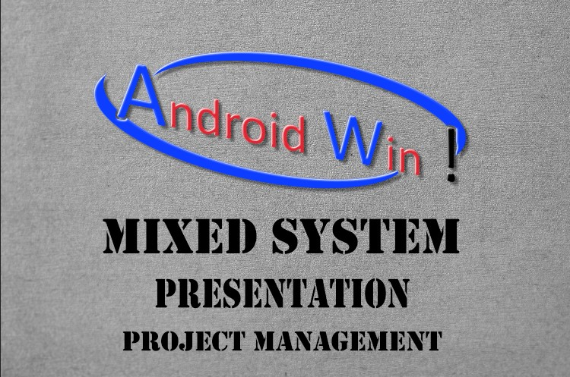

Slide 2
Android Win(AW)
Project objective.
The result of our project is to reduce the waste time and making easy for users to do something or doing their job easily from home with their phones by this system.

Slide 3
Android Win(AW)
requirements !!
Often times, a product or service will have technical requirements to ensure Proper performance. Technical requirements usually describe either output or Specify performance specifications.

Slide 4
Android Win(AW)
For example, in an AW system, it will require a Strong network and service that can handle both systems and users who have the Ability to understand how the system works, and it will require high-performance Hardware to be able to run both systems together.

Slide 5
Android Win(AW)
limits this systme.
Android win system can Integration between Android and Windows systems, where it can run android applications as Windows programs.
It can connect to normal android like Windows. We can run this system on computers, but it cannot be run on iOS mobile because weak capabilities of mobile.

Slide 6
Android Win(AW)
time and cost this system.
The project should be completed within one year and 3 months at a cost not to exceed 800.000$.

